Slide 1

Ma-Chef Learning
Paul Salessi, Michael Rea, Alex Parella, Ge (Claire) Cheng, Jiaming Xie, Mazar Farran, Corbin Gomez, Carl Glahn, Kenan Nalbant, Weitang Liu

Slide 2

Introduction to Project - What’s Cooking
Our task was to create a classifier that, given a list of ingredients, could predict what cuisine type (Italian, Indian, etc.) the recipe belonged to.
We were given 40,000 training samples in a large JSON file that had a cuisine, an ID number, and then a list of ingredients for the dish

Slide 3
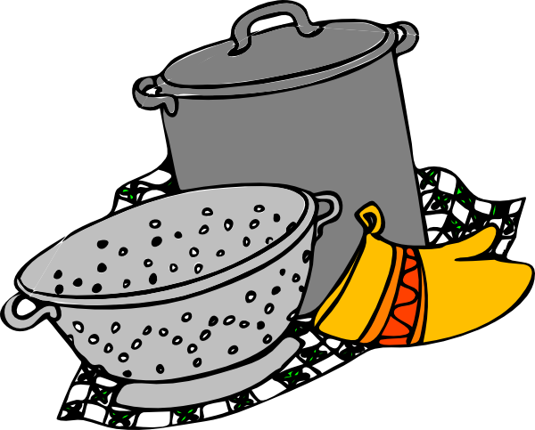
Introduction to Project – Our Goal
Implement a learning model that achieved at least a 70% accuracy level
Divide and conquer
Implemented decision trees, artificial neural networks, support vector machines and naive bayes.

Slide 4

Decision Trees

Slide 5
Decision Trees – What are they?
Map out a deterministic series of questions that eliminate possible outcomes until there is only one possibility
Applied to our problem, we essentially ask if the recipe calls for a particular ingredient.
If yes, then we eliminate all cuisines that do not contain that ingredient
If no, then ask about a different ingredient
We implemented a more advanced method called random forest which generates multiple decision trees and averages them for better accuracy

Slide 6
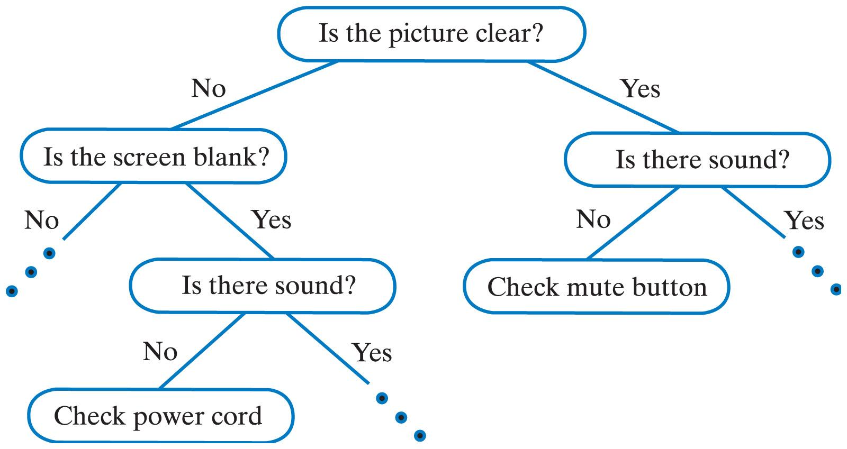

Decision Trees – Examples
A tree showing survival of passengers on the Titanic ("sibsp" is the number of spouses or siblings aboard). The figures under the leaves show the probability of survival and the percentage of observations in the leaf. Credits to Wikipedia

Slide 7
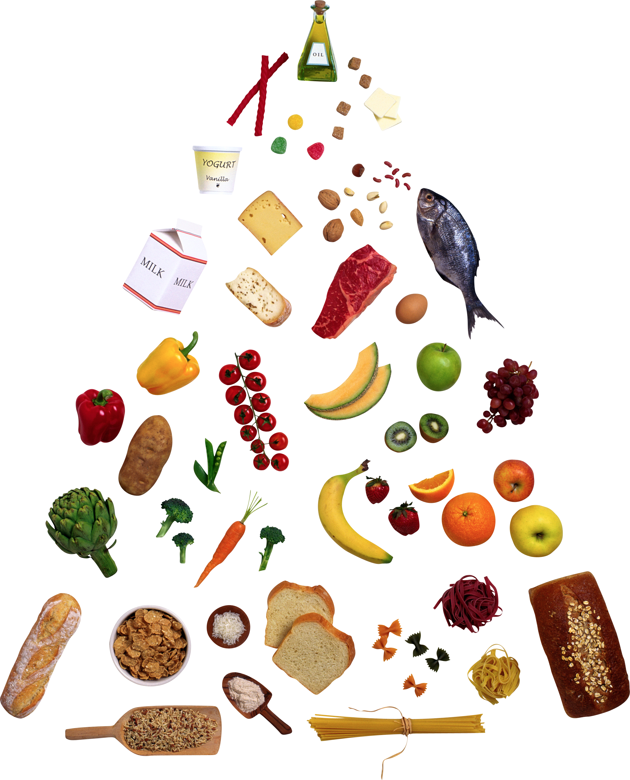
Decision Tree – Algorithm/Feature Selection
Created a bag of words
Huge matrix: 39774 x 6681
Over 99% sparse
Removed all terms in bag that appeared in less than 1% of the recipes
Dropped number of ingredients from 6681 to 194
Still 97% sparse
First, tried building a single decision tree model
Got 37% accuracy on Kaggle
Tried a random forest model to improve accuracy and error

Slide 8
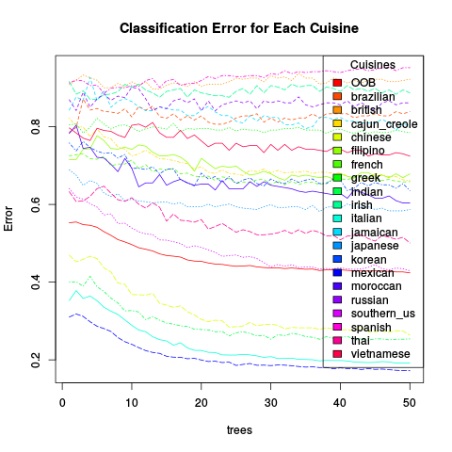
Decision Tree – Results/Insight
Random forest achieved 61% on Kaggle with using 50 trees
Splitting the complete data into training and testing
Model accuracy: 84.35% when using the testing data
Out-of-bag estimate of error rate: 42.41%
Spanish error classification: 95.18% (worst)
Mexican error classification: 17.20% (best)
Sparse bag of words took up a lot of memory and computation time
Could have tried other feature selection techniques to improve accuracy

Slide 9
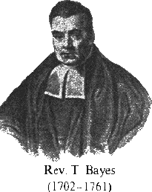
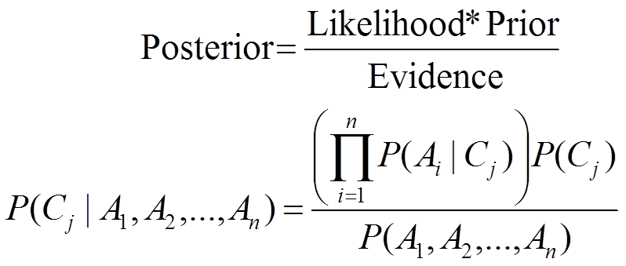
Naïve Bayes

Slide 10
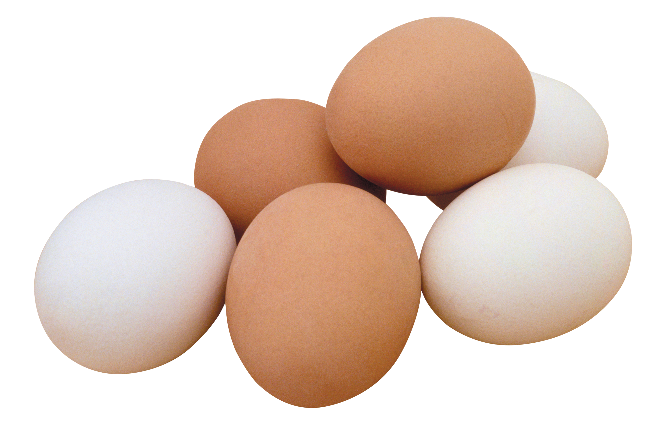
Naïve Bayes – Introduction
Naïve Bayes is a simple classification method which takes advantage of Bayes’ Theorem.
It assumes each feature is independent of the others; hence, it is a naïve estimator.

Slide 11
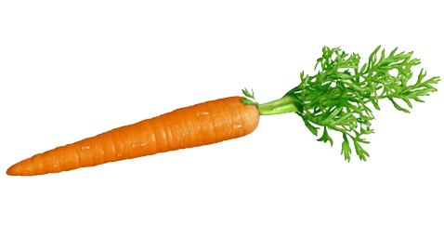
Naïve Bayes – Method
A multi-class implementation of a Naïve Bayes classifier was made in Java.
The frequency of each ingredient in each cuisine is counted, as well as the frequency of each cuisine.
This data is used to find the likelihood of each sample belonging to a certain class (cuisine).
Classification with the highest likelihood is selected.

Slide 12
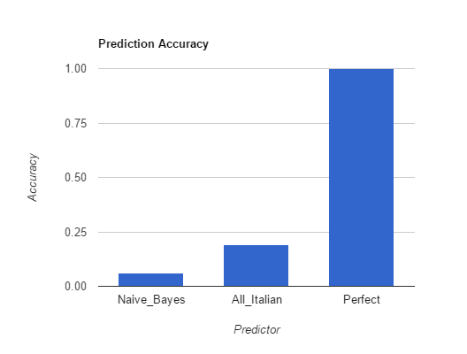
Naïve Bayes – Results

Slide 13

Naïve Bayes – Discussion
Prediction accuracy is at 6%, likely because the naïve assumption of feature independence is too naïve for this problem.
Compare this to assuming every cuisine is Italian, with 19% accuracy.
Dimensionality reduction may help reduce the error rate.
In short, this type of implementation is likely inappropriate for the problem at hand.

Slide 14

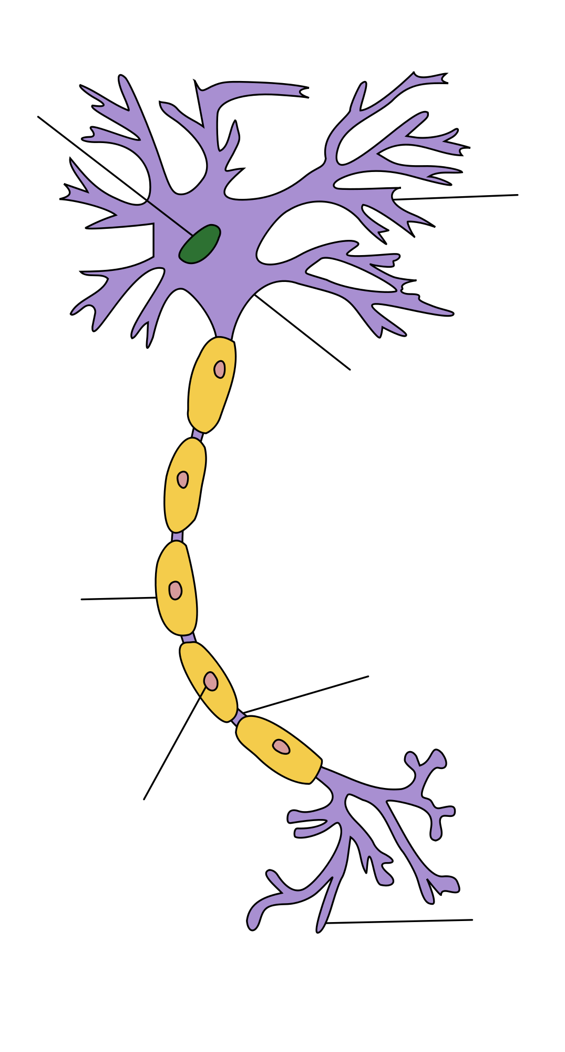
Neural Nets

Slide 15
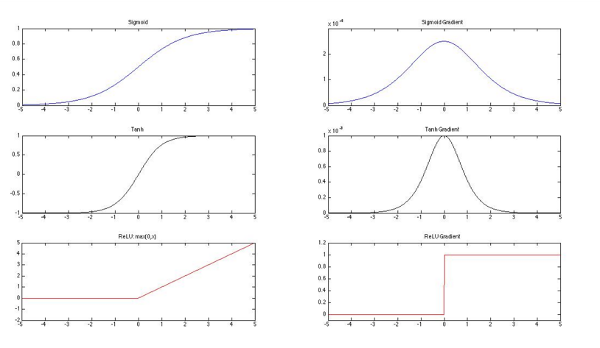
Neural Nets – Transfer Functions

Slide 16
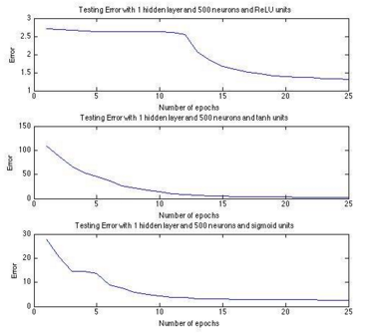
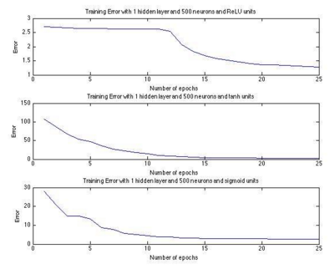
Neural Nets – Train and Test Errors

Slide 17
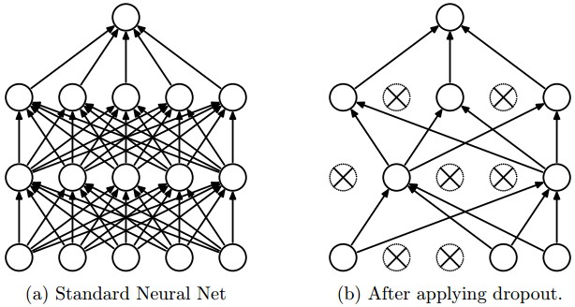
Neural Nets – Dropout

Slide 18

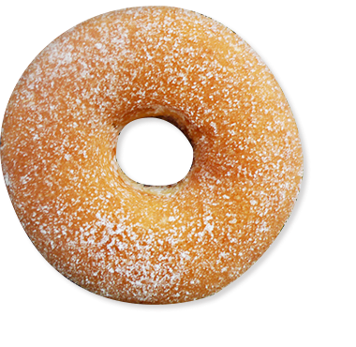
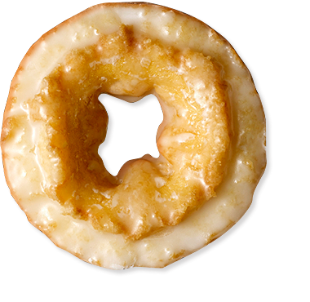
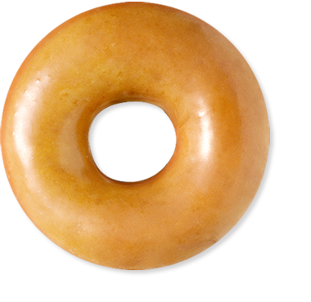
Neural Nets – Results
Training Accuracy : 40-50%
Testing Accuracy : 15-20%
Kaggle Accuracy : 20%
Performance concerns limited topology options

Slide 19
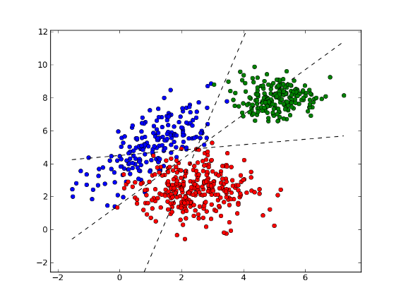
Support Vector Machines
Example of Multiclass Support Vector Machines:

Slide 20
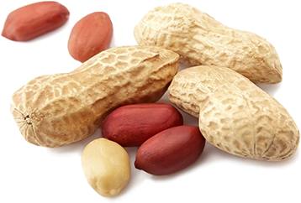
Support Vector Machine – Method Overview
Steps:
Two ways to do Principal components Analysis
Apply support vector machine in our data sets

Slide 21
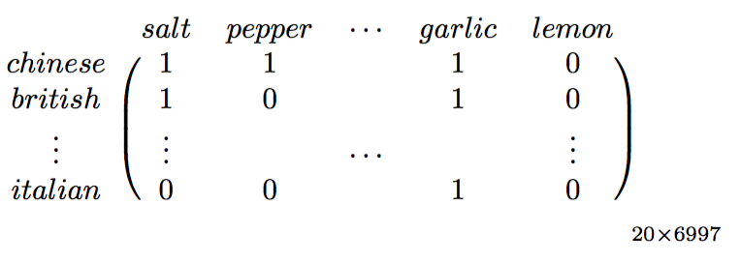
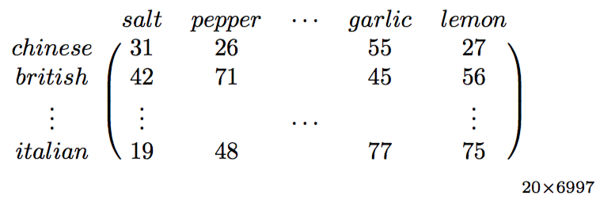
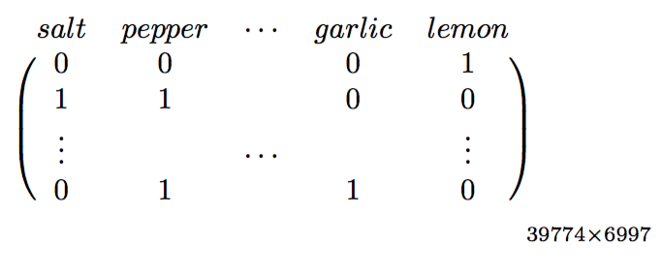
Support Vector Machine
Apply PCA on three different data sets:
 | binary summary matrix | weight summary matrix | whole data binary matrix
Format:
Accuracy: | 60% | 61% | 74.4%
Efficiency(running time): | 3min | 2min | 6 hours

Slide 22
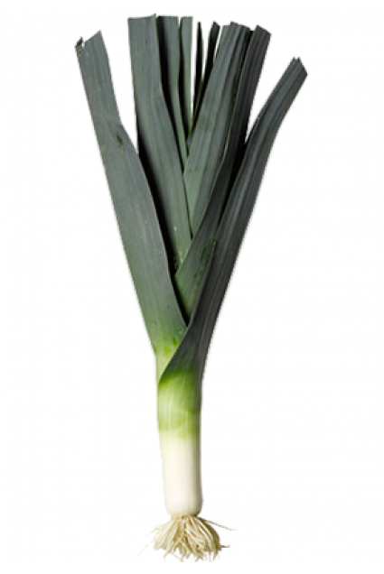
Support Vector Machine
Method: One-against-one
Kernels: (Apply PCA on whole data binary matrix)
Fail case: Bessel, ANOVA
 | Linear | Gaussian
PCA variability 95% | 70% | 74.4%
PCA variability 98% | 69% | 71%

Slide 23
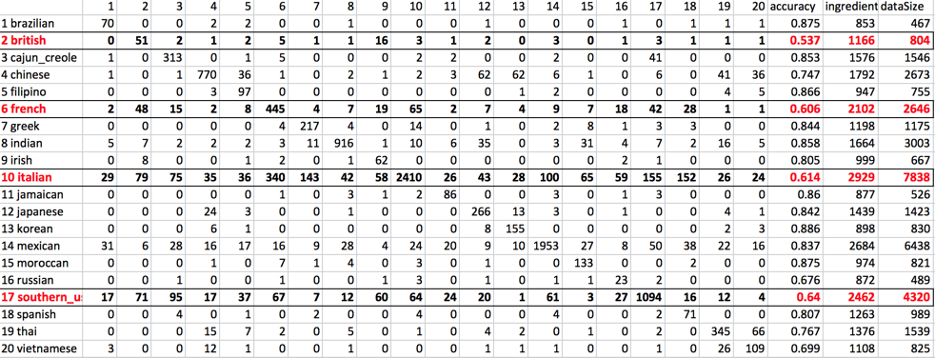
Support Vector Machine – Results

Slide 24
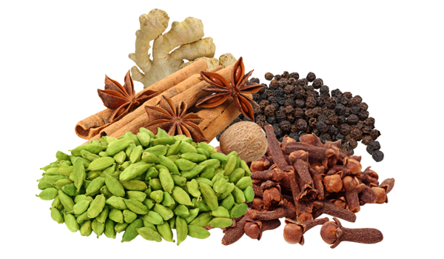
Support Vector Machine – Improvements
Nonlinear dimensionality reduction
(e.g. Principal Curves and manifold)
Stacking
(training a learning algorithm to combine the predictions of several other learning algorithm)

Slide 25

Final Comparisons & Thoughts
Did we meet our goal? (70% accuracy of each model)
Why did some models do well while others did not?
Future work? How could things have been done better?
Any other implications?

Slide 26

Questions?

